Slide 1
FPGA Implementations of Initial-Value Problem Solving Methods
Nick Eyre

Slide 2
initial-value problems
Yay, ME Stuff!
Notes:
Ordinary differential equations with initial conditions
Commonly used in fields such as Dynamics to solve Newton’s second law

Slide 3
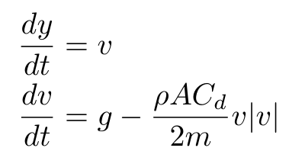
Baseball
Dynamics is fun!
Notes:
Second-order diff eq for baseball
Ignores Magnus force
State variables hold state
Two states here
Transform our units to let us use all integers.
Centiseconds and micrometers

Slide 4
Simulink for HDL Modeling
Because why not?
Notes:
Simulink, part of MATLAB, is a powerful graphical programming language.
Used frequently in industry, especially in controls and signal processing.
Can be compiled into clocked HDL code.

Slide 5
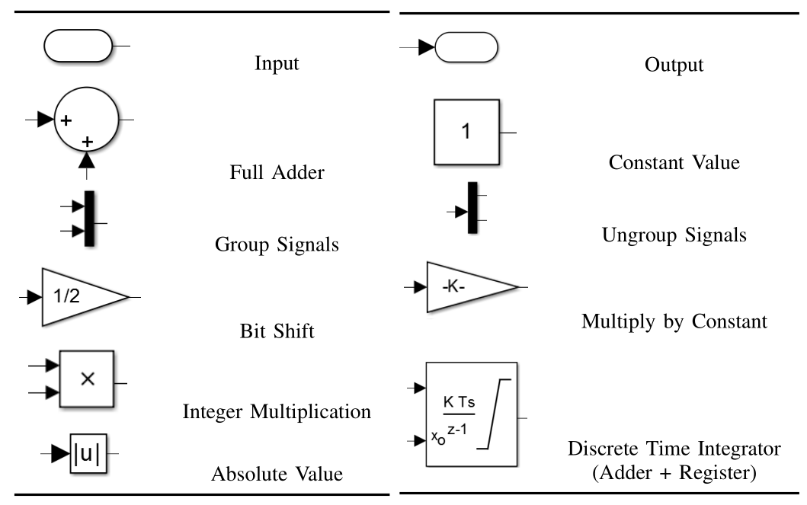
The Toolbox
So much power.

Slide 6
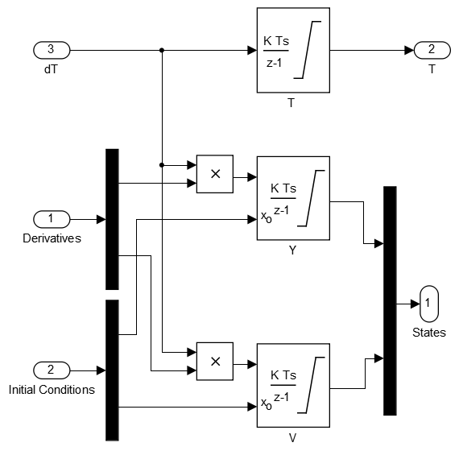
State Integrator Module

Slide 7
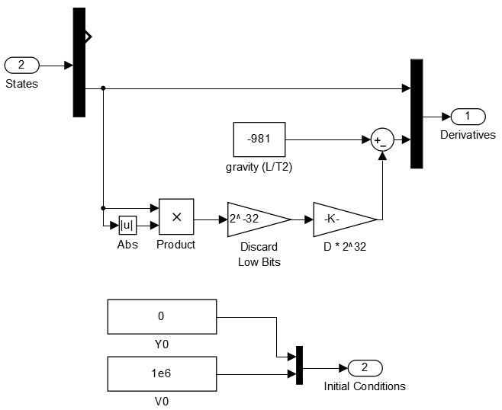
Dynamic Model Module
Understanding the world is cool.

Slide 8
Euler’s method
Starting off slow…

Slide 9
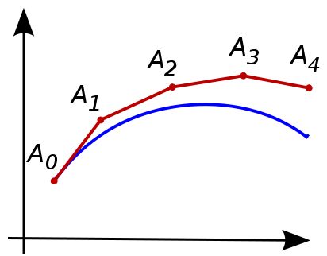
Adding it all Up
Such error, wow.

Slide 10
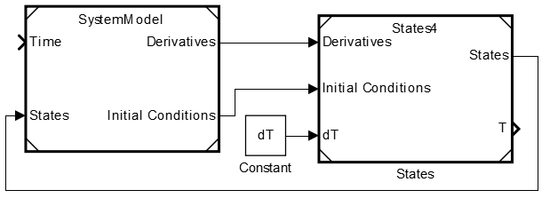
Euler’s Implementation
If Euler used Simulink…

Slide 11
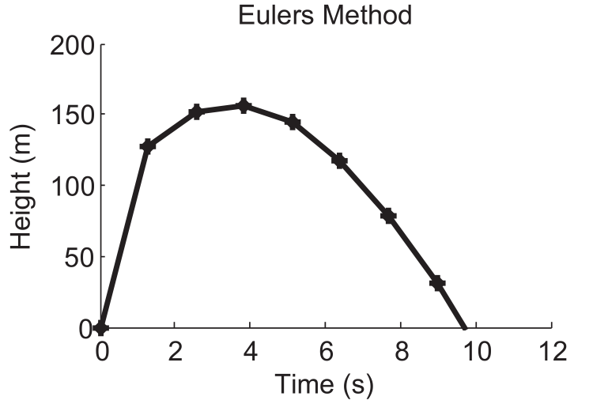
Euler’s Results
Pretty sure his plots never looked that pretty

Slide 12
A Bright Idea
Geometry!
Notes:
What if we look backwards too instead of forward?

Slide 13
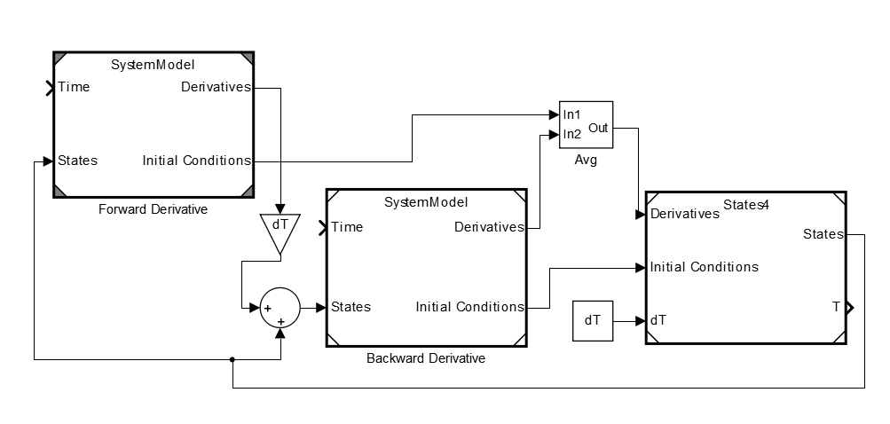
Trapezoidal Euler’s Method

Slide 14
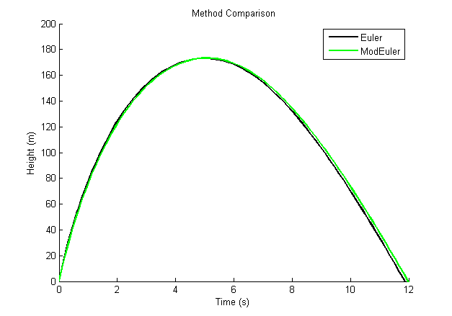
Comparison of Results

Slide 15
Conclusions
Musings on parallelism, clock speed and more

Slide 16
Future Work
More state variables?
Convert to Verilog?
Floating point?
Adaptive-timestep solver?
Trig functions?
Synthesize with MATLAB?

Slide 17
Simulink for HDL Modeling
Because why.
Notes:
Simulink, part of MATLAB, is a powerful graphical programming language.
Used frequently in industry, especially in controls and signal processing.
Can be compiled into clocked HDL code.

Slide 18
Questions, comments?
You know you want to.
Notes:
Simulink, part of MATLAB, is a powerful graphical programming language.
Used frequently in industry, especially in controls and signal processing.
Can be compiled into clocked HDL code.

